Slide 1

How to Sell AP Automation to Your Organization
+
Insert Your Company Logo Here

Slide 2
AGENDA
Overview of AvidXchange
What is AP and Payment Automation?
Impact of Automating Payables
Return on Investment
45-Day Implementation

Slide 3
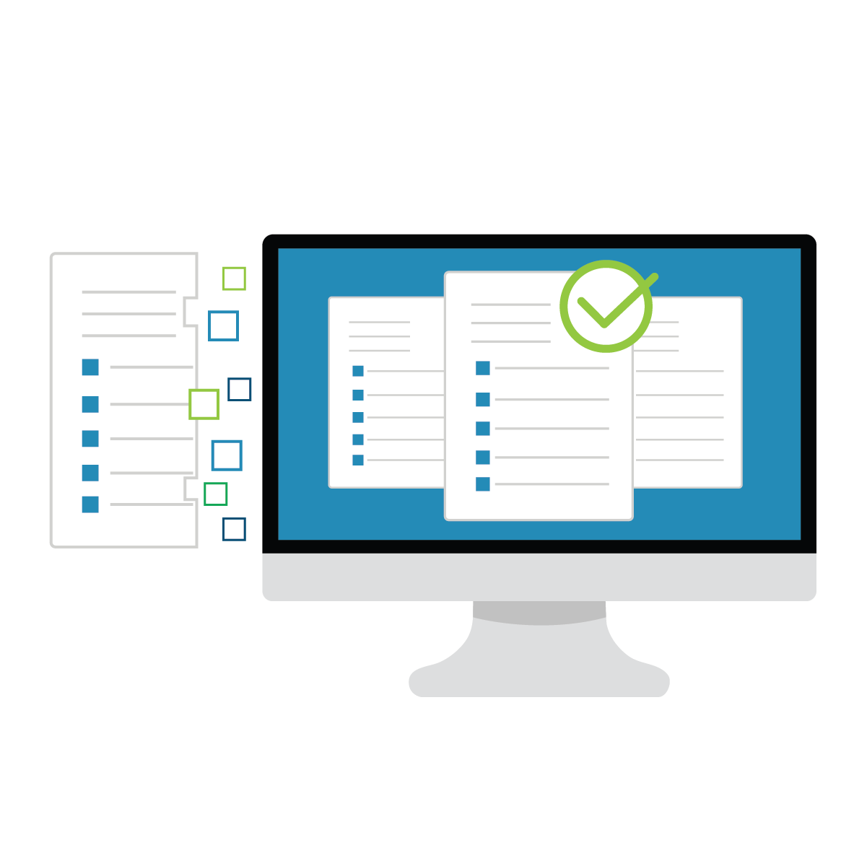
WHO IS AVIDXCHANGE?
AvidXchange revolutionizes the way companies pay their bills
An industry leader in automating invoice and payment processes for midmarket companies
More than 6,000 clients throughout North America

Slide 4
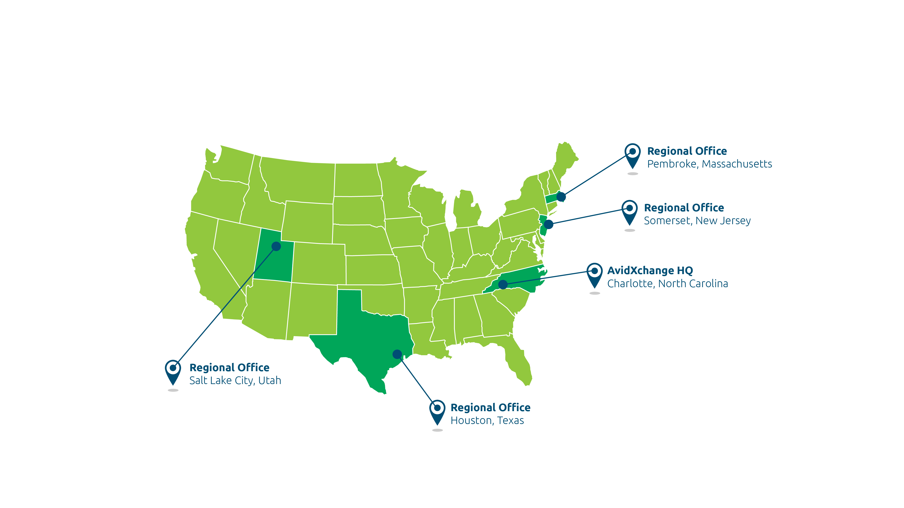
LOCATIONS

Slide 5
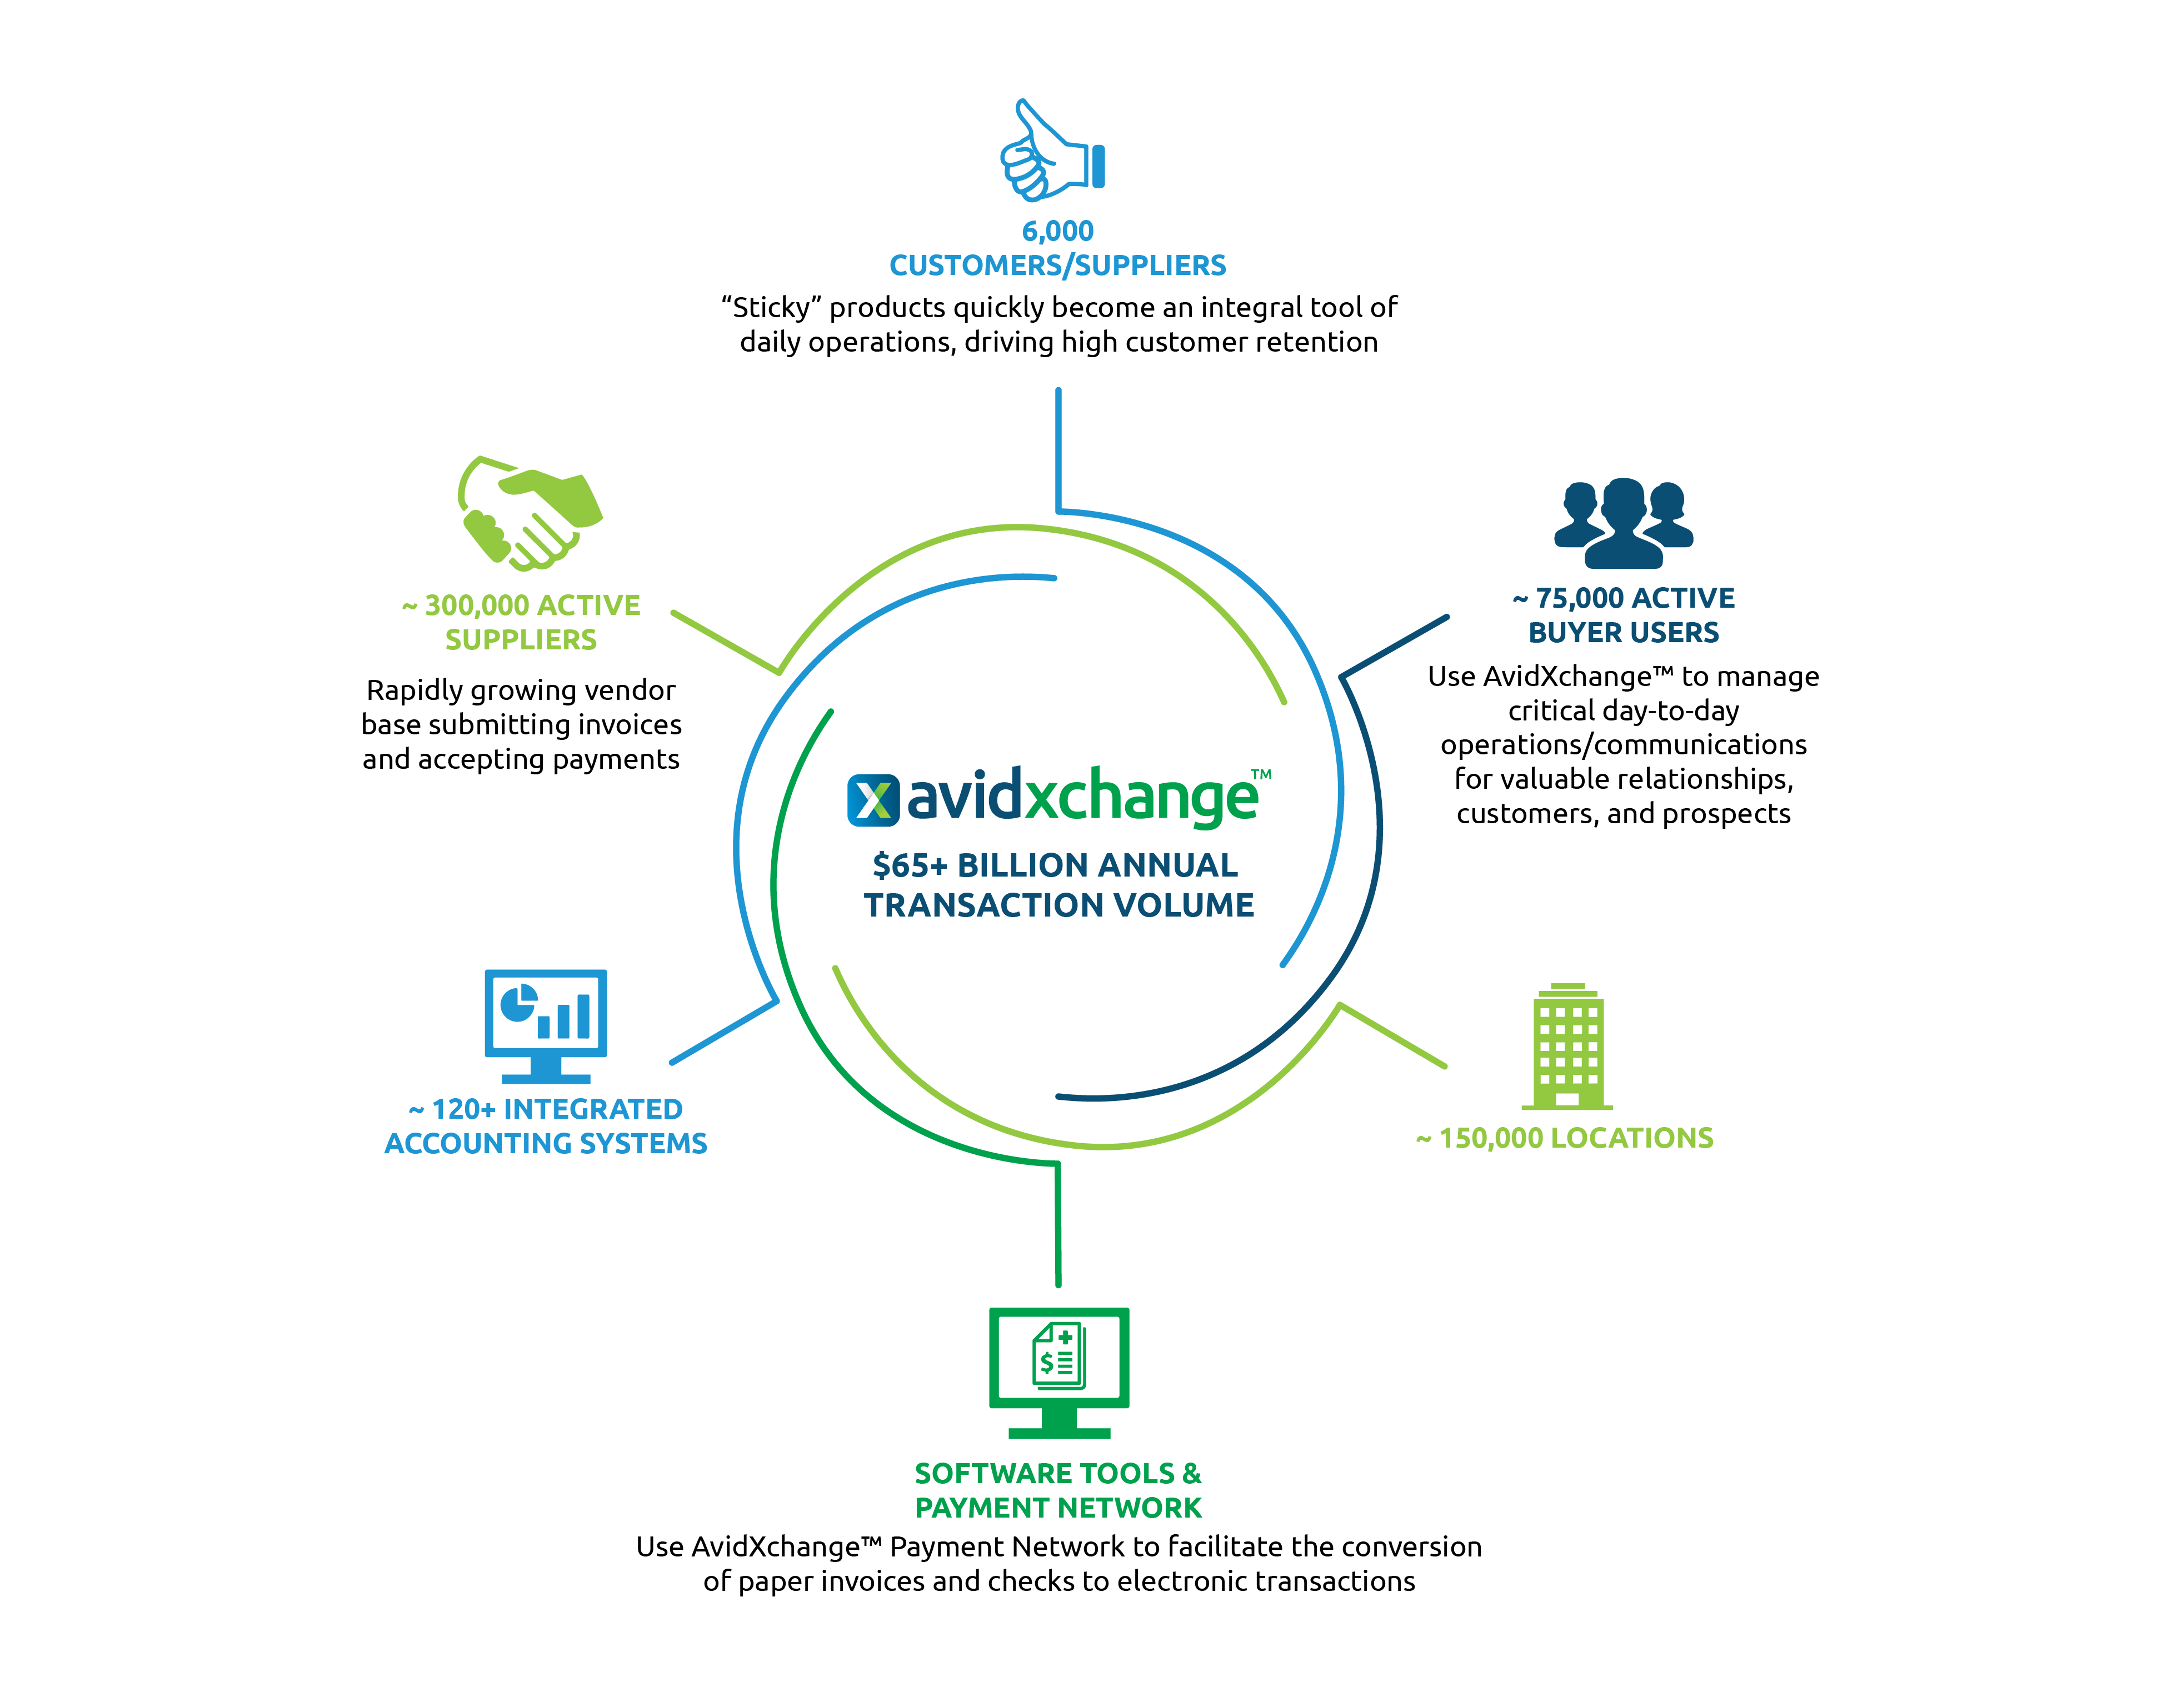

Slide 6
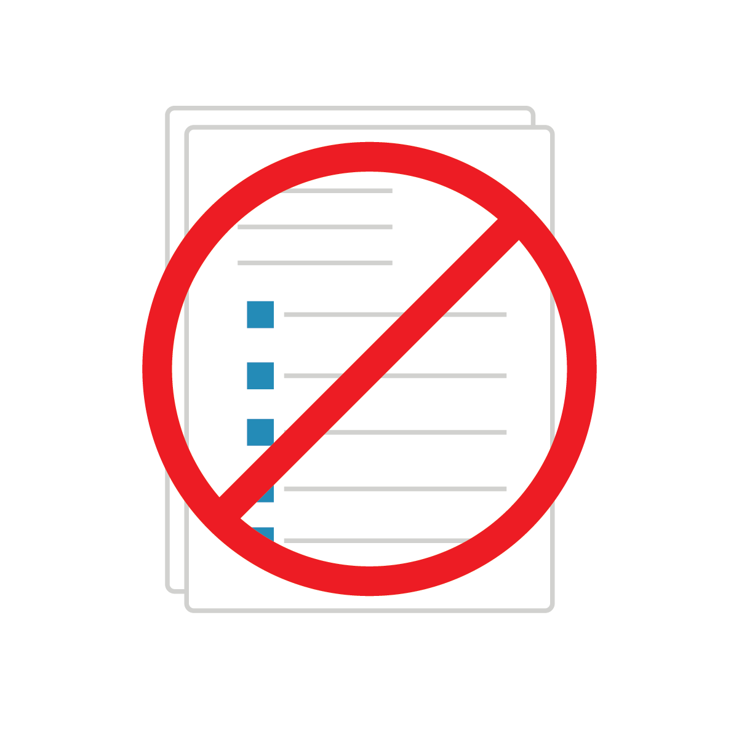
WHAT IS AP AND PAYMENT AUTOMATION?
A cloud-based solution that integrates with accounting systems to help companies streamline their accounts payable workflows, removing manual tasks and paper in the process
Eliminates tedious tasks like opening the mail, entering data manually, and filing stacks of paper
Eliminates paper invoices and checks altogether, to create more time for strategic tasks

Slide 7
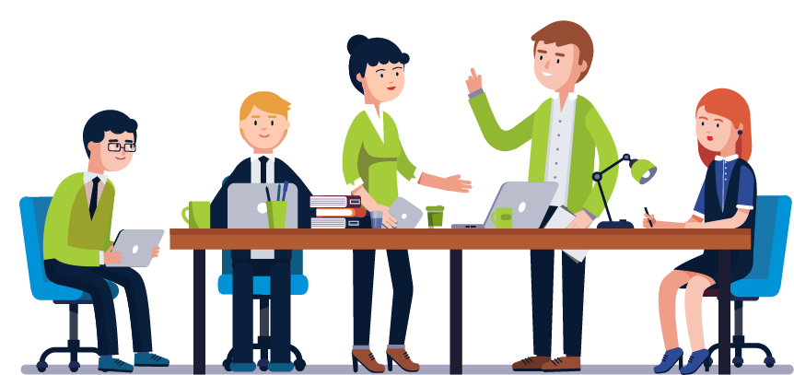
Automation does NOT mean eliminating team members.
It ALLOWS AP members to work smarter and more strategically.
Notes:
According to research by Robert Half, baby boomer retirements are accelerating, and more finance
professionals are leaving the field than are entering it. Having grown up with technology, younger
generations expect to do everything electronically. Therefore, it will be increasingly difficult to
attract, and retain, AP professionals that are millennials with outdated, paper processes in place.
Do you have a seasoned veteran on your team who is retiring soon? If so, you may lose decades
of valuable knowledge about your organization’s accounts payable process. These experienced
employees have their own shorthand for coding invoices. Before these invaluable veterans leave
the company for good, it’s important to capture their best practices. When implementing an automation solution, you can attend hands-on configuration sessions to
create an automated process that mimics your current process, translating a veteran employee’s
knowledge built into business rules and intelligent approval workflows. While you may lose a coworker,
you won’t lose their expertise!

Slide 8

BENEFITS OF AP AND PAYMENT AUTOMATION
Automation reduces operating costs and processing time up to 60%
Time saved can be utilized to negotiate vendor discounts and rebate procurement, rather than copying and scanning files or searching for misplaced invoices

Slide 9
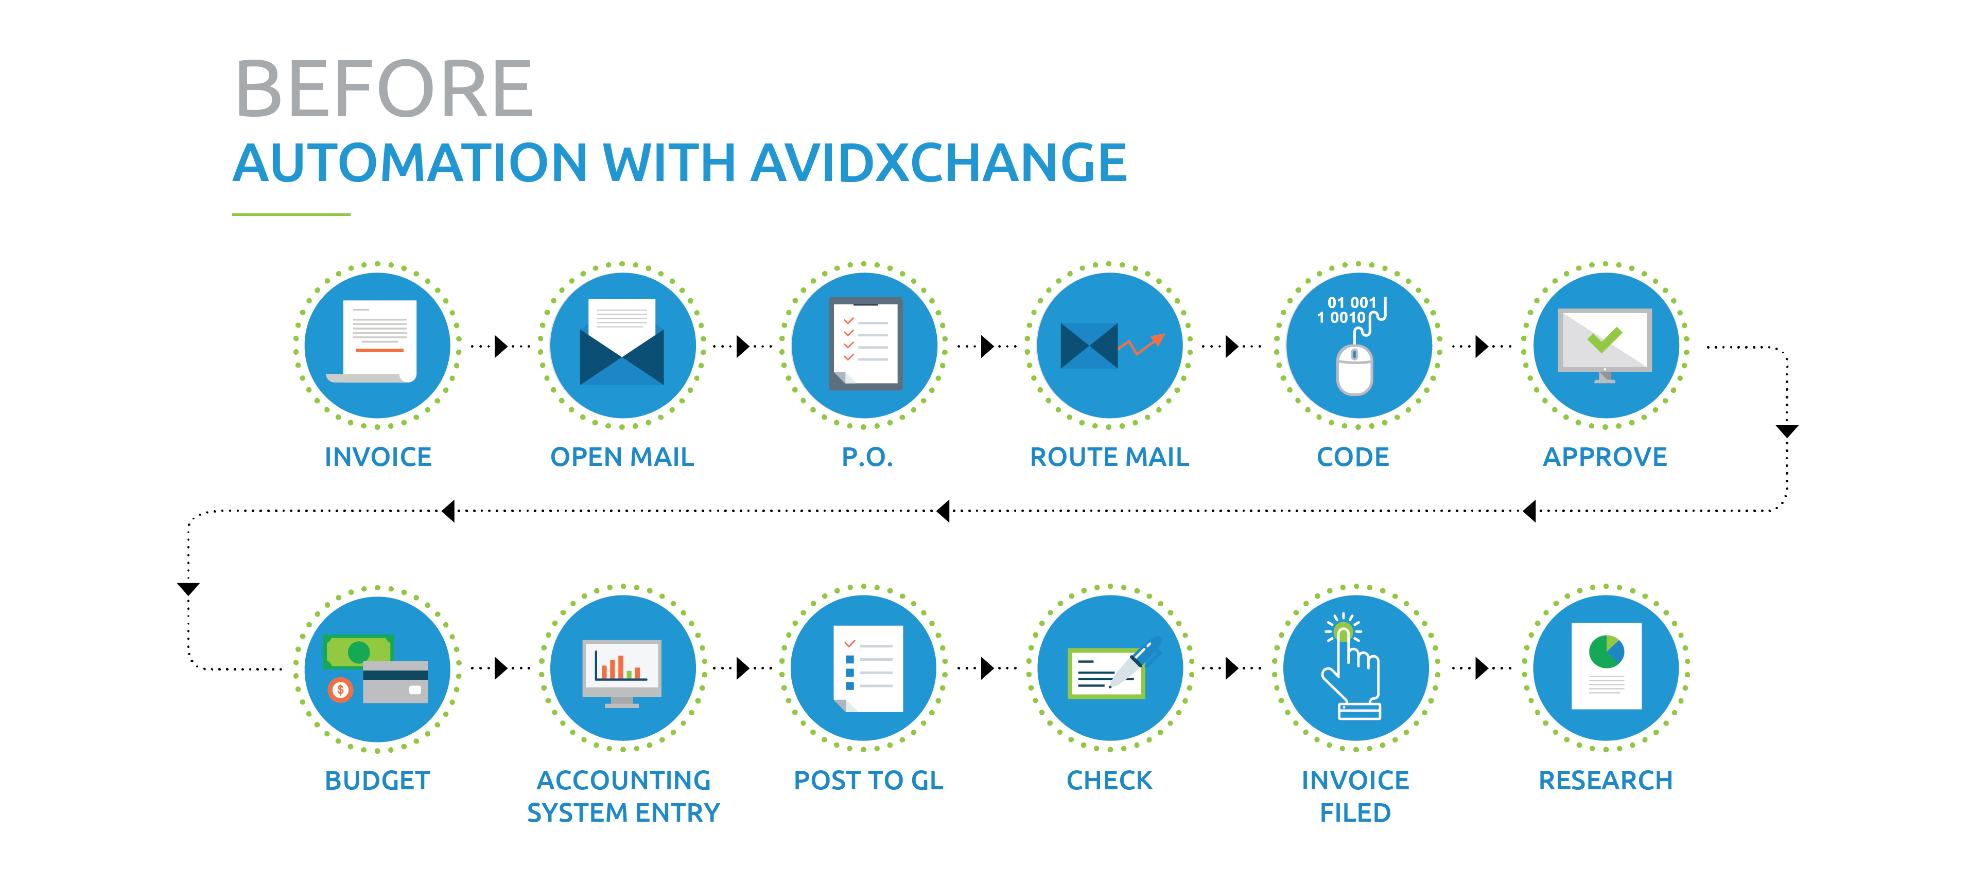
Notes:
This is a typical AP process before automating AP

Slide 10
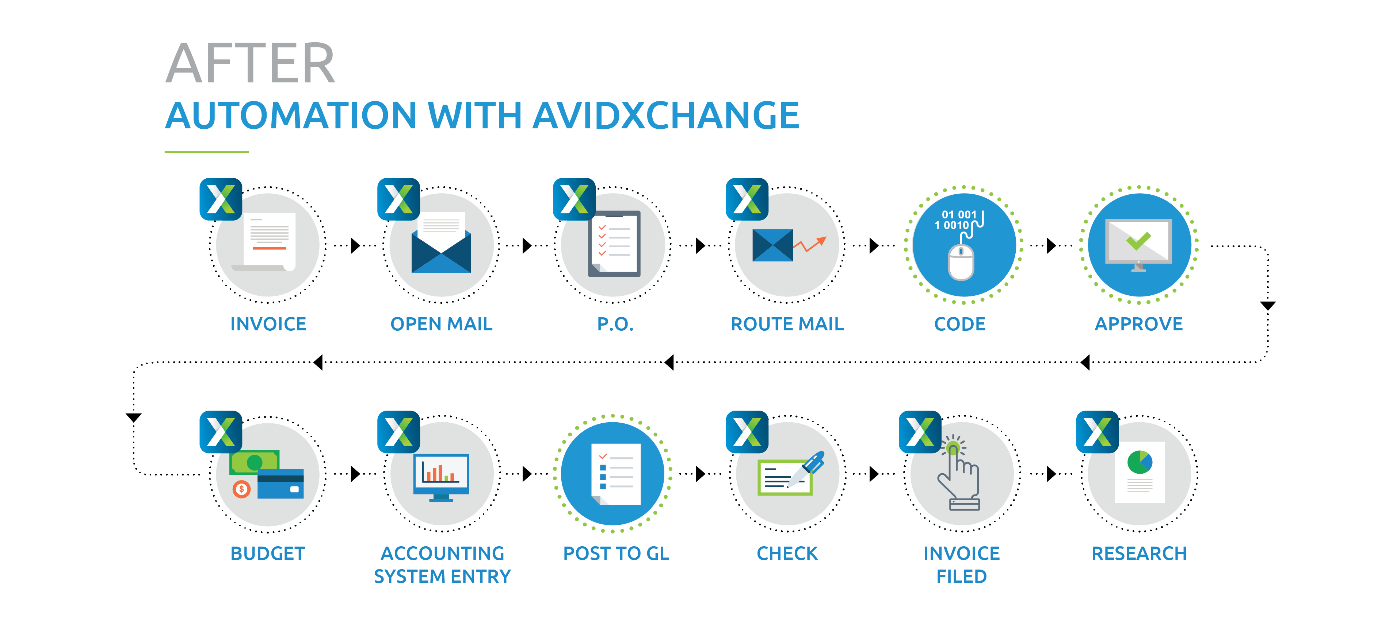

Slide 11
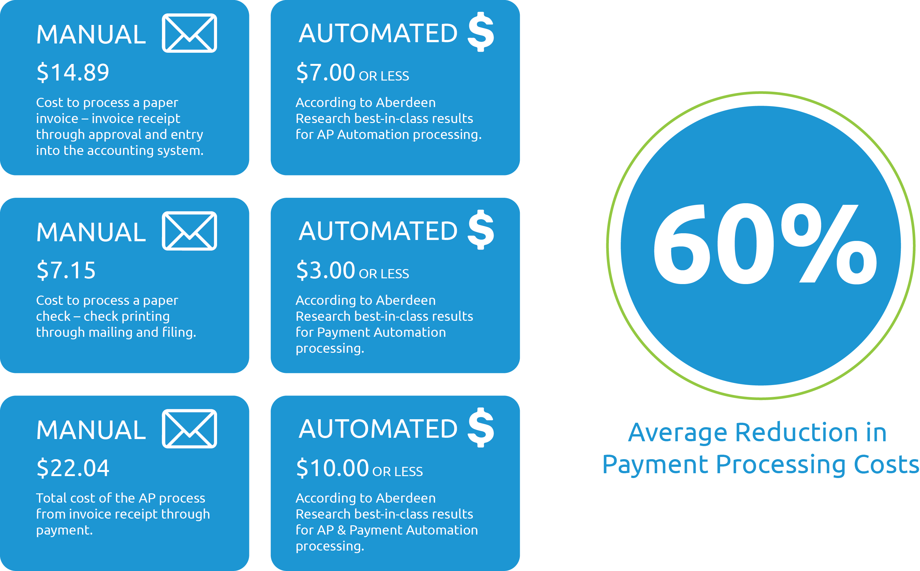
IMPACT OF AUTOMATING PAYABLES

Slide 12
HOW AP AND PAYMENT AUTOMATION TIGHTENS INTERNAL CONTROLS
Configurable workflows
Invoices can be routed by type (i.e., utility vs. standard), department, vendor, dollar amount, etc., without manual intervention.
Pay controls (or workflows) can be set up for payments
Permission based visibility into invoice and payment data
Our staff members will only have access to invoices if reviewing, coding, and/or approving is required.
Positive Pay is included
Available for all checks cut by AvidXchange
AvidXchange manages the Positive Pay file for us
Reconciliation
[Insert your accounting system name] remains our system of record, and we will receive files with all the payment information needed for reconciliation
Cash Flow Management
We decide when payments are processed and paid
FOR INVOICES
FOR PAYMENTS

Slide 13
IMPACT OF AUTOMATING PAYABLES

Slide 14
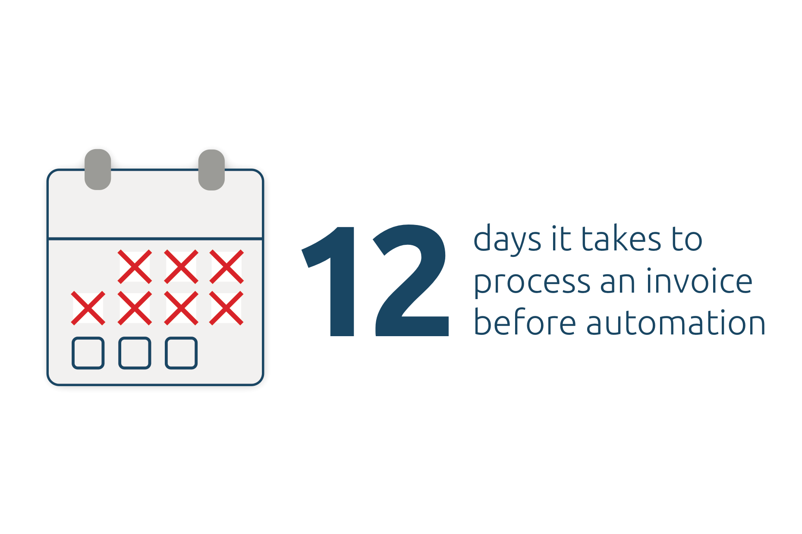
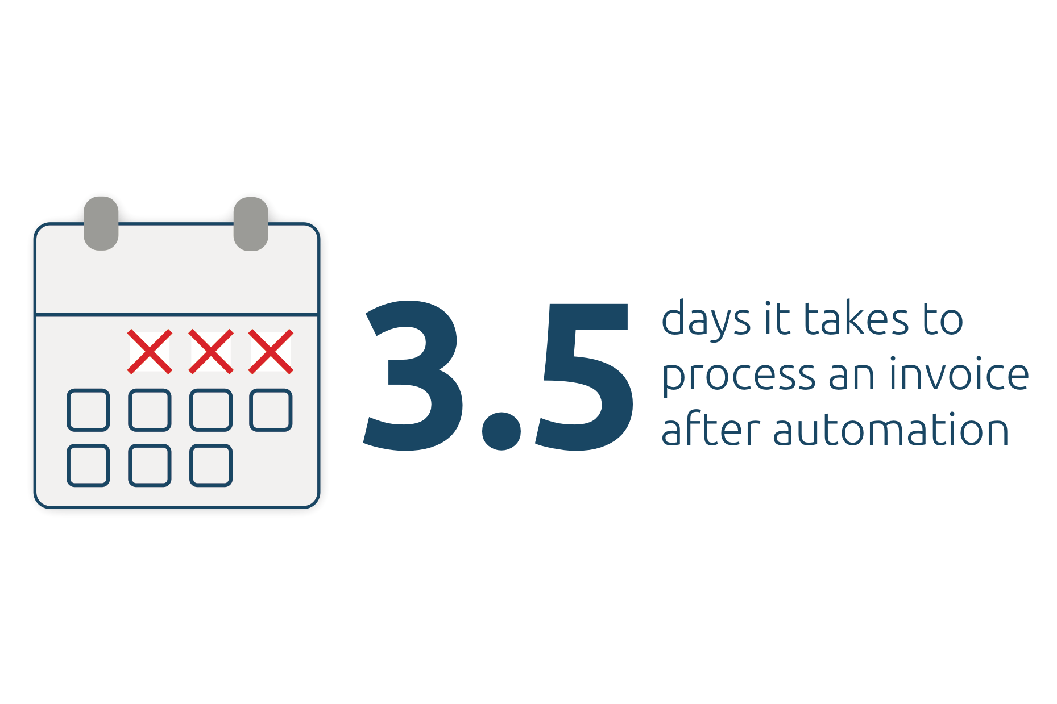
IMPACT OF AUTOMATING PAYABLES

Slide 15

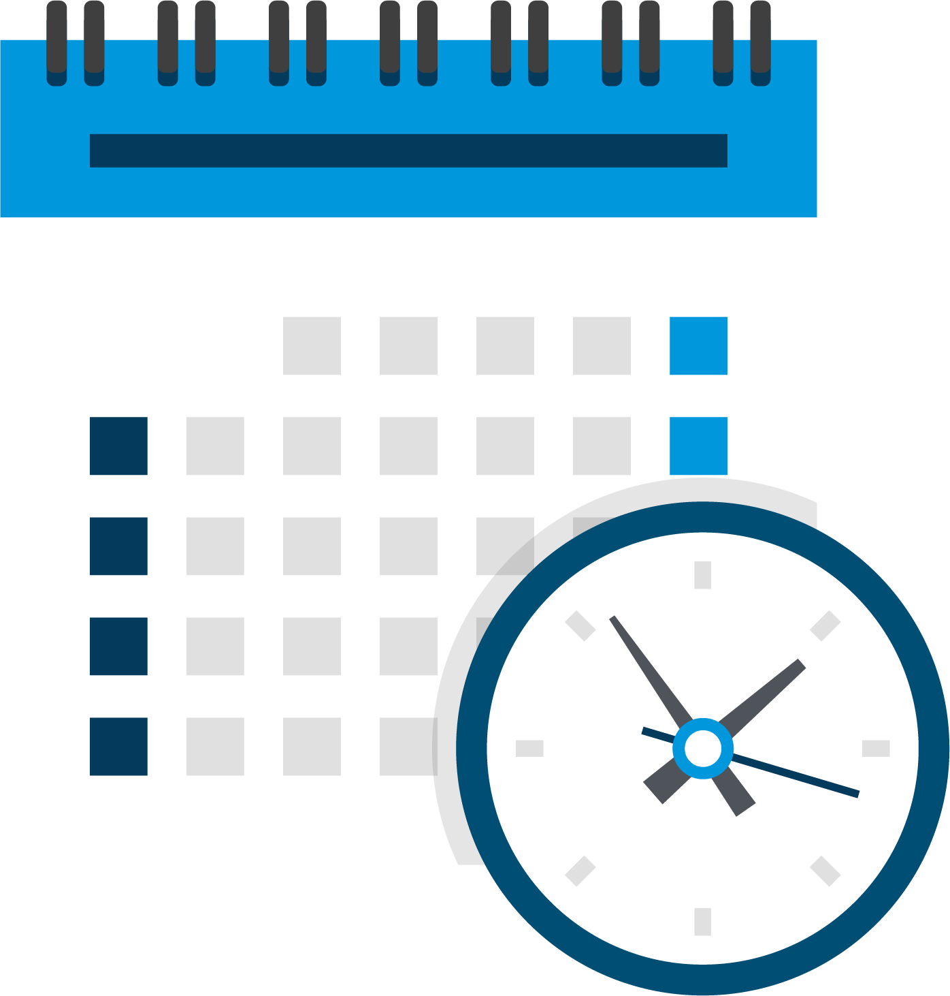
ROI CALCULATOR RESULTS
Edit Numbers based on ROI Calculator Results
$0.00
Your Total Savings Per Month
0
Your Man Hours Saved Per Month

Slide 16
ROI CALCULATOR RESULTS
Edit Numbers below –> Chart Design -> Edit Excel Data

Slide 17
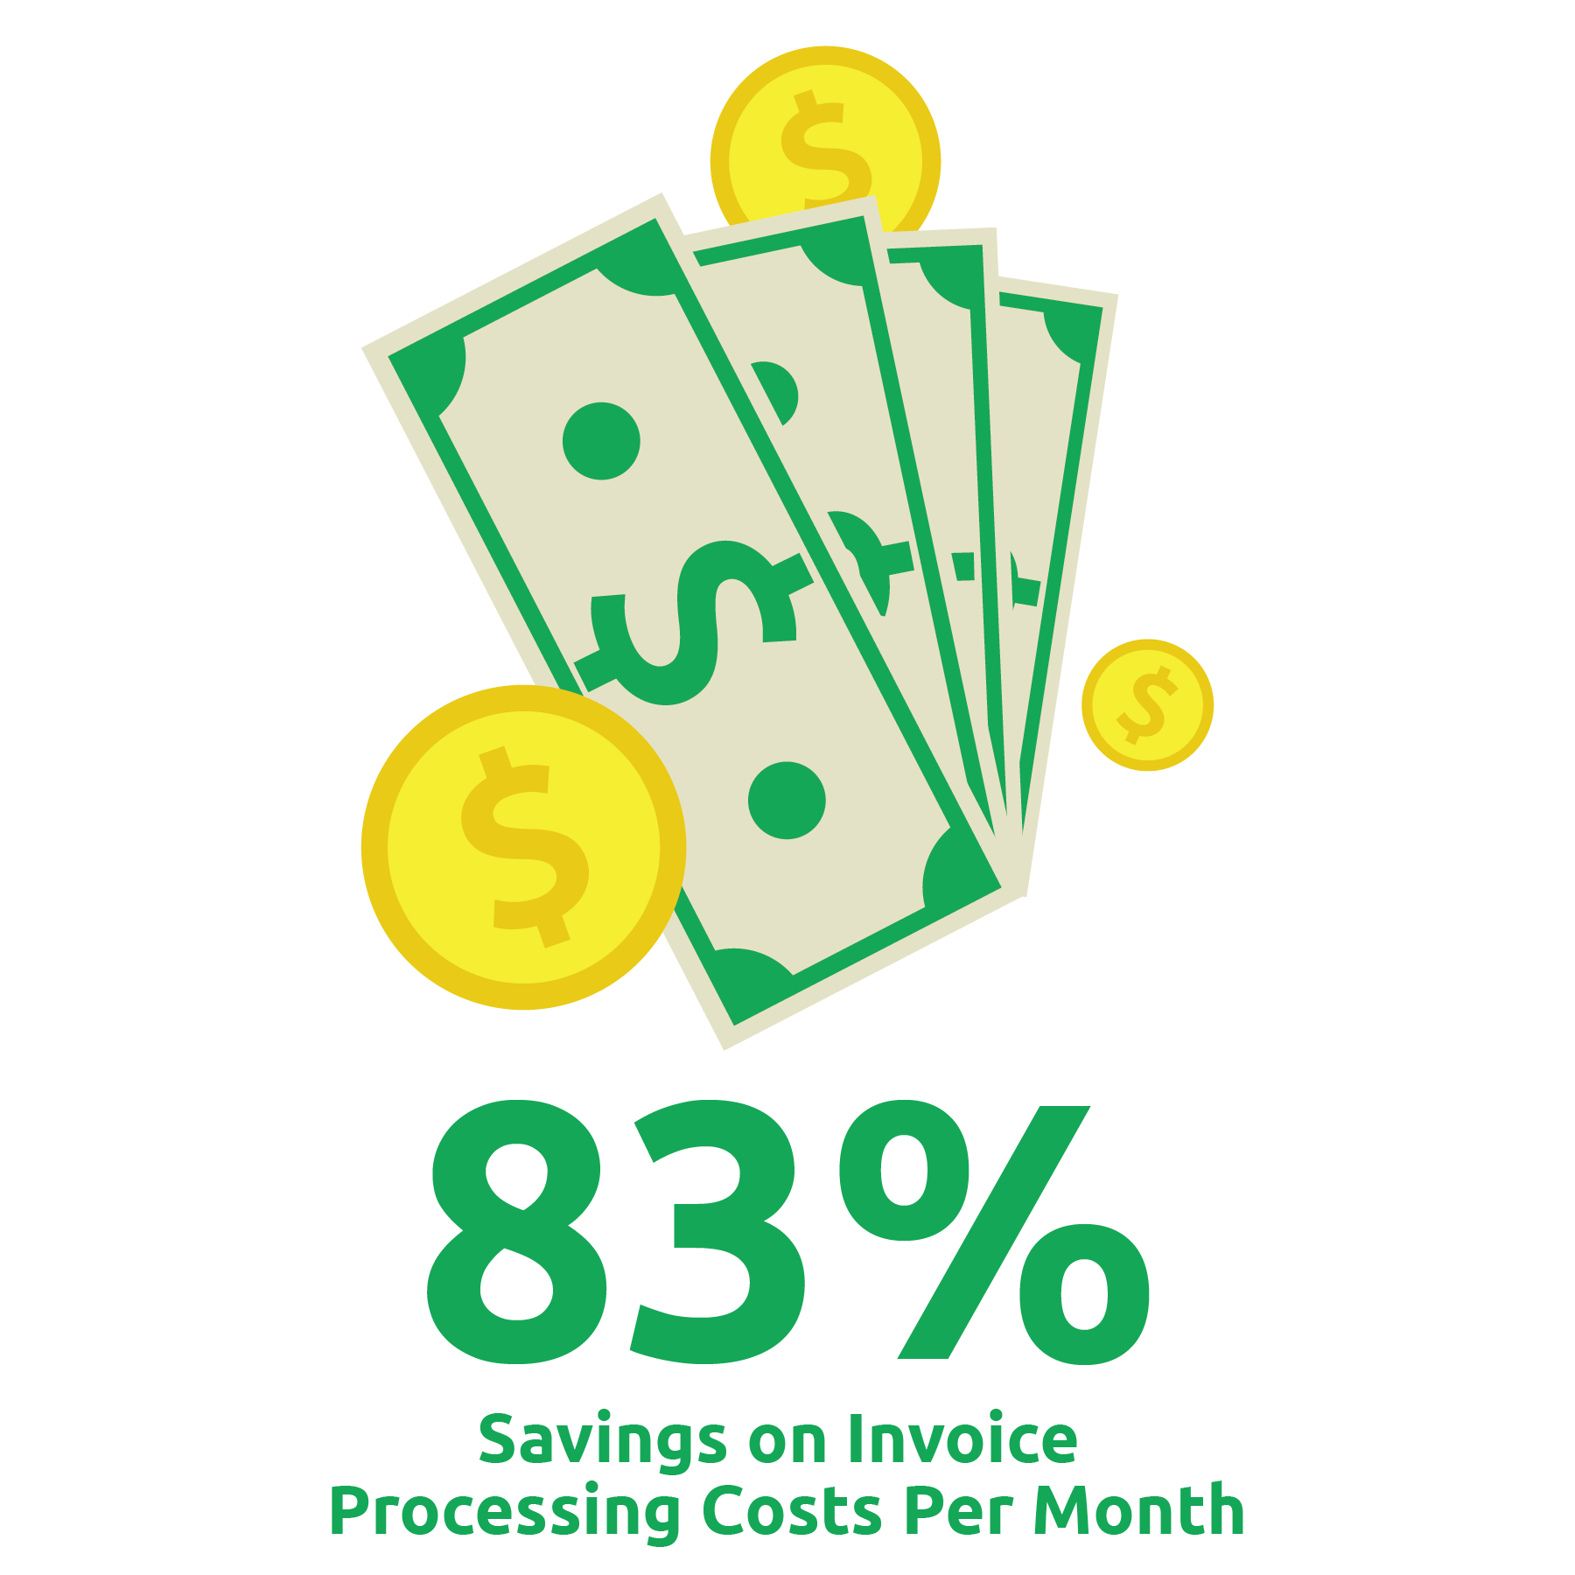
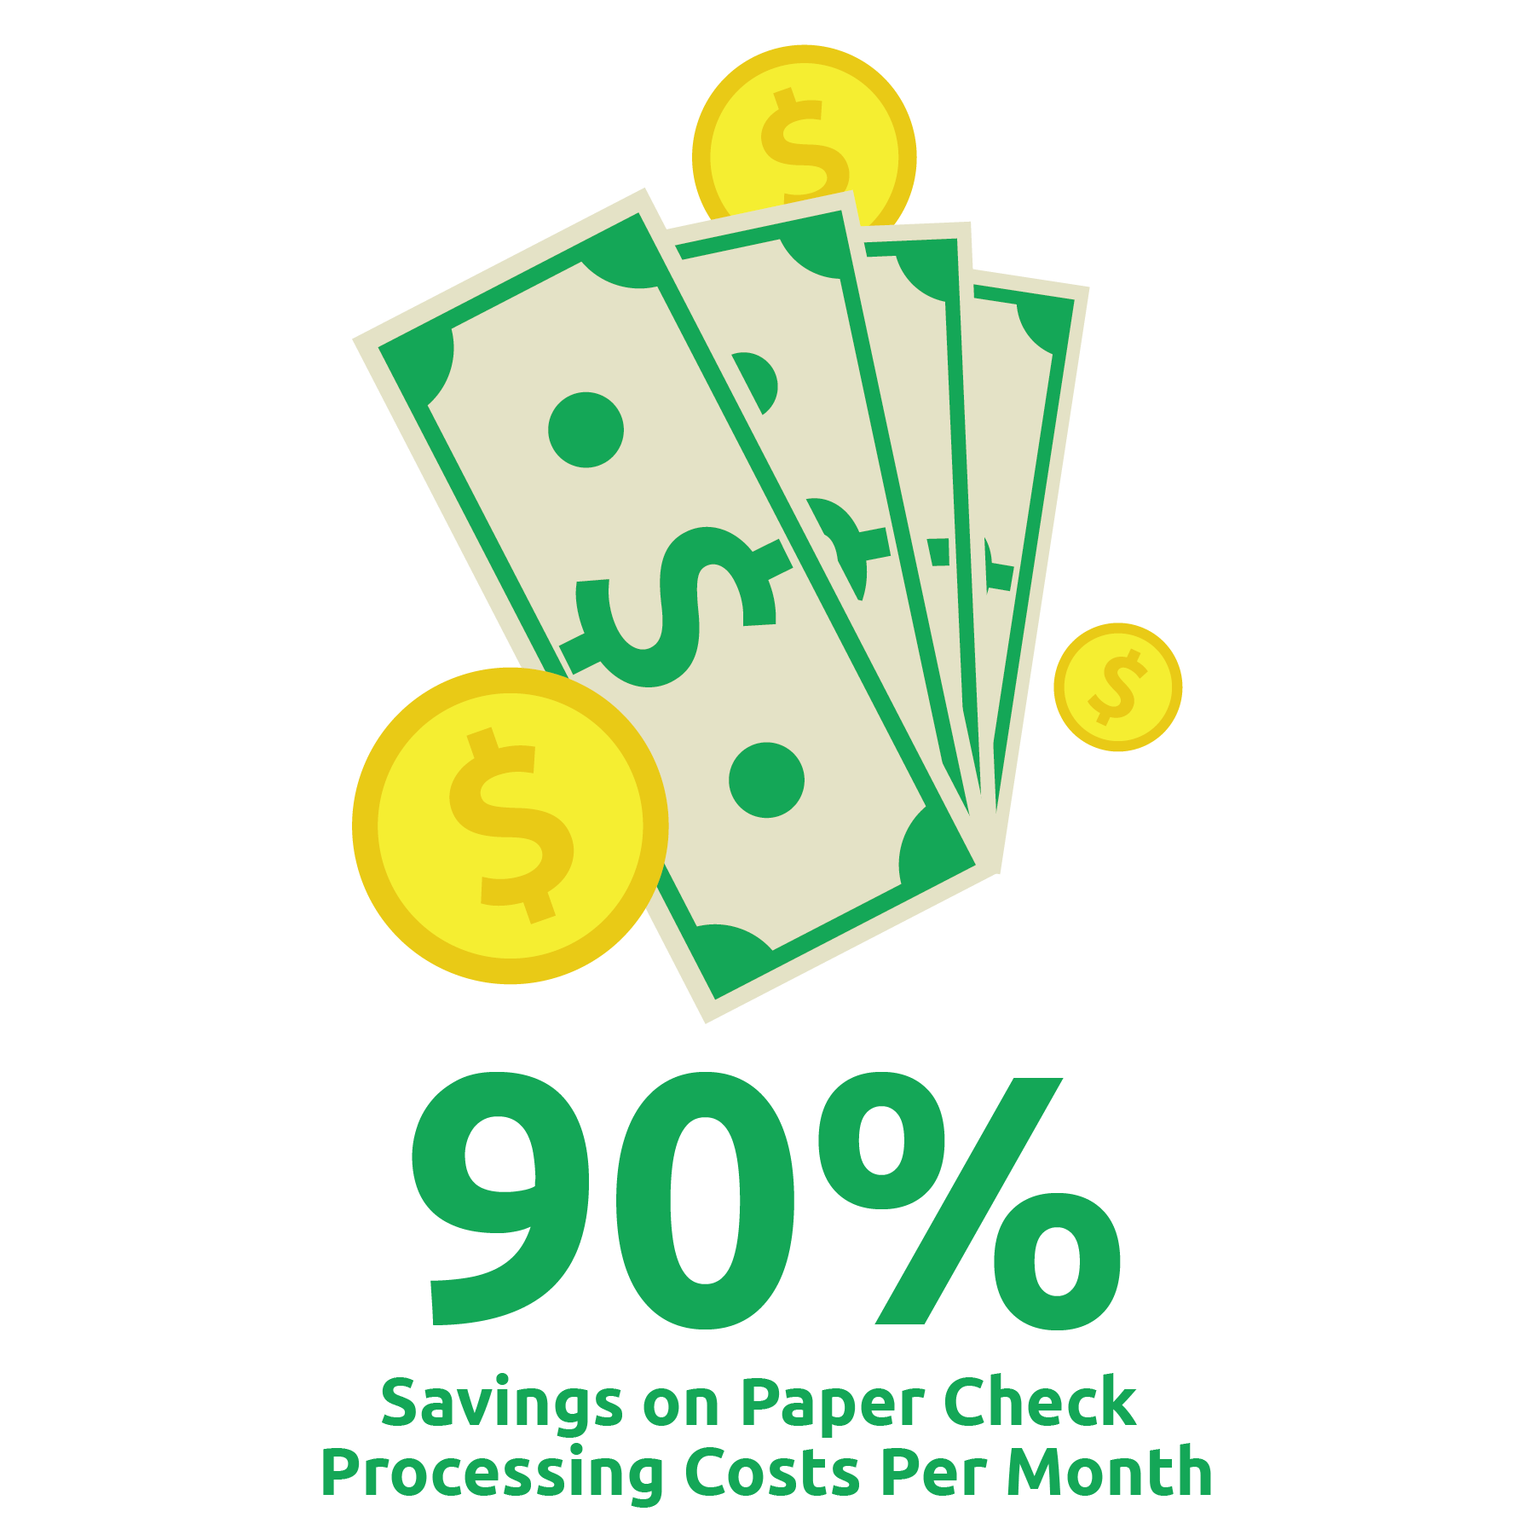
ROI CALCULATOR RESULTS

Slide 18
45-DAY IMPLEMENTATION
Why should we automate?
It will immediately save time and money, and also enable our AP department to pursue higher value tasks that will contribute to the bottom line (ex: reviewing financial statements)
Add your own value statement here
Add your own value statement here
Why now?
We can save approx. $[insert results from ROI calculator] in 2018, if we automate before the end of January.
AvidXchange has a 45-day implementation guarantee, so we can get up a running with little to no disruption
Add your own value statement here
Add your own value statement here

Slide 19
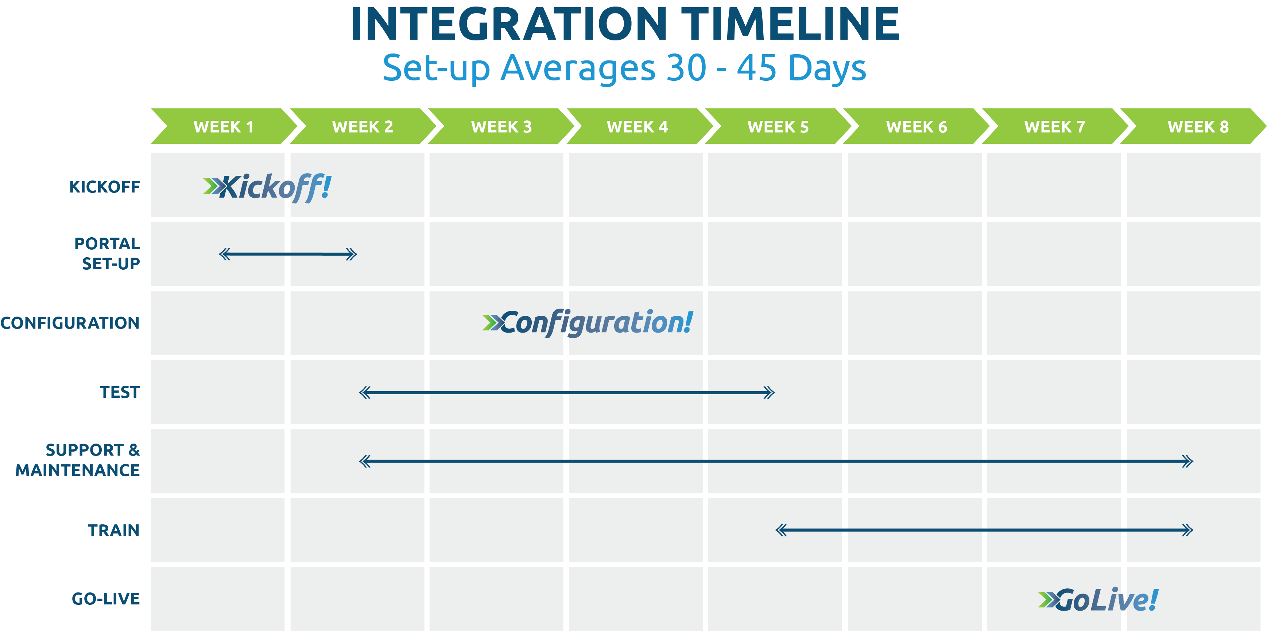

Slide 20


QUESTIONS?

Slide 21
Thank you for attending!
+
Insert Your Company Logo Here

